Slide 1
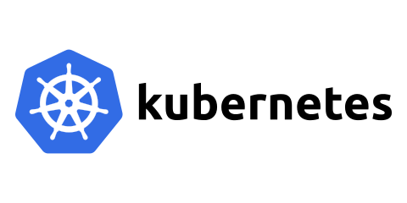
By Elsa Yunia
(165410019)

Slide 2
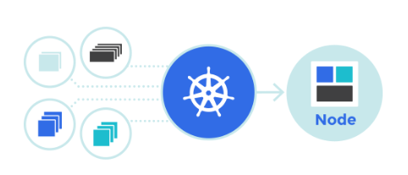
What is Kubernetes?
Kubernetes is an open source system for managing containerized applications across multiple hosts, providing basic mechanisms for deployment, maintenance, and scaling of applications

Slide 3
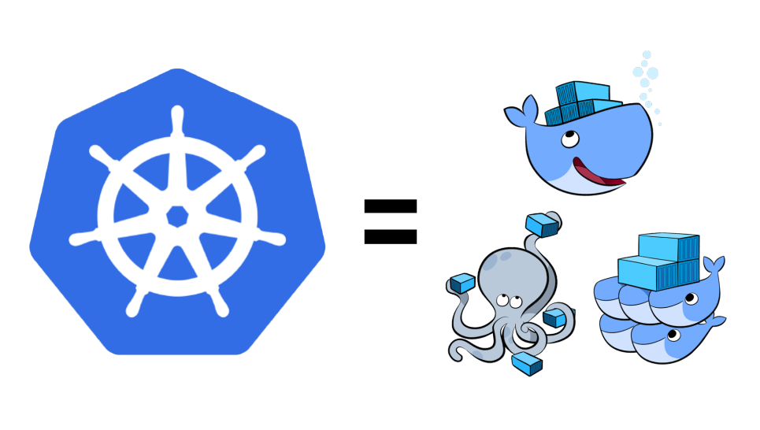

Slide 4
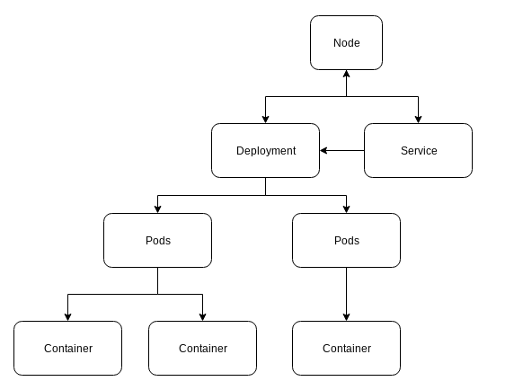
Structure

Slide 5
Kubernetes Cluster
A Kubernetes cluster typically consists of:
The Master Server
Nodes
A Container Runtime
A Network
The Kubernetes API

Slide 6
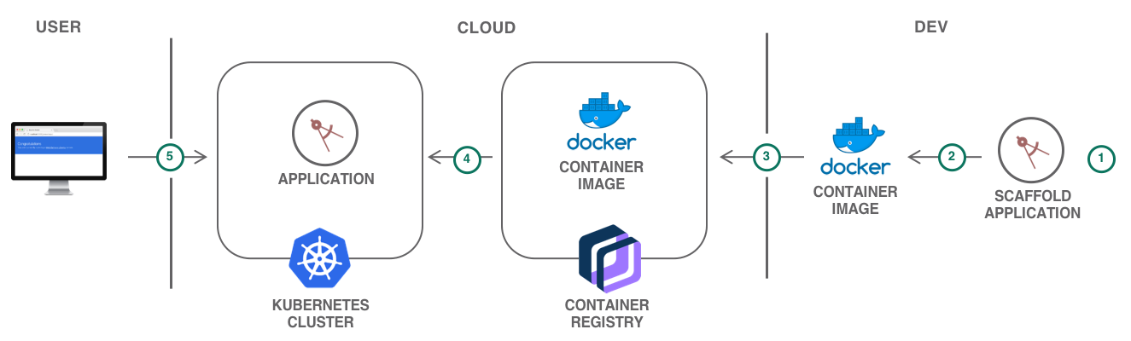
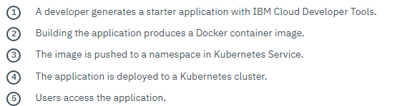
Architecture

Slide 7
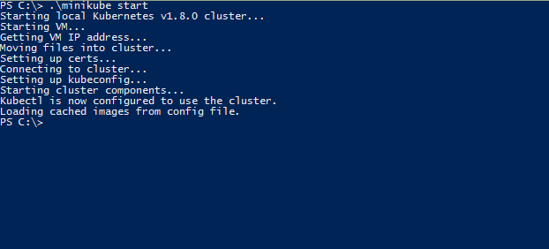
Getting Started With Kubernetes
Minikube start

Slide 8
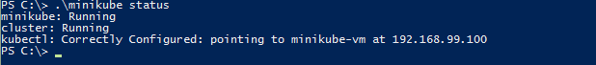
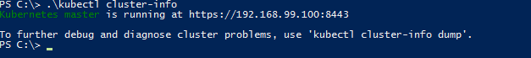

Getting Started With Kubernetes
Minikube status

Slide 9
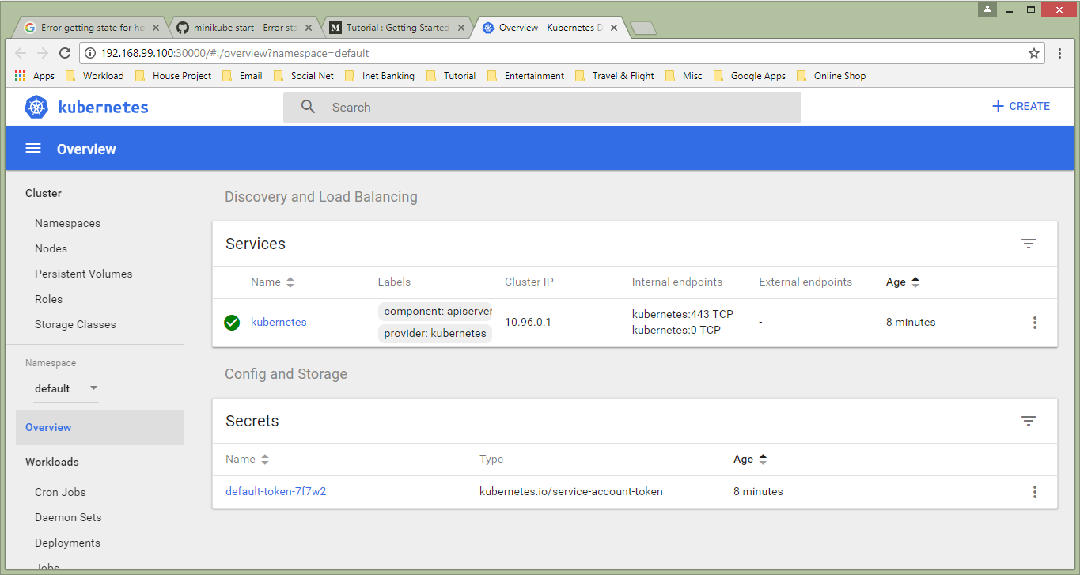
Kubernetes Dashboard

Slide 10
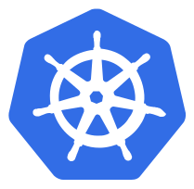
Thank You ☺

